Slide 1
Local Government Playbook: Vehicle Electrification in San Antonio
Julia Murphy, AICP, LEED AP
Deputy Chief Sustainability Officer
September 14, 2022

Slide 2
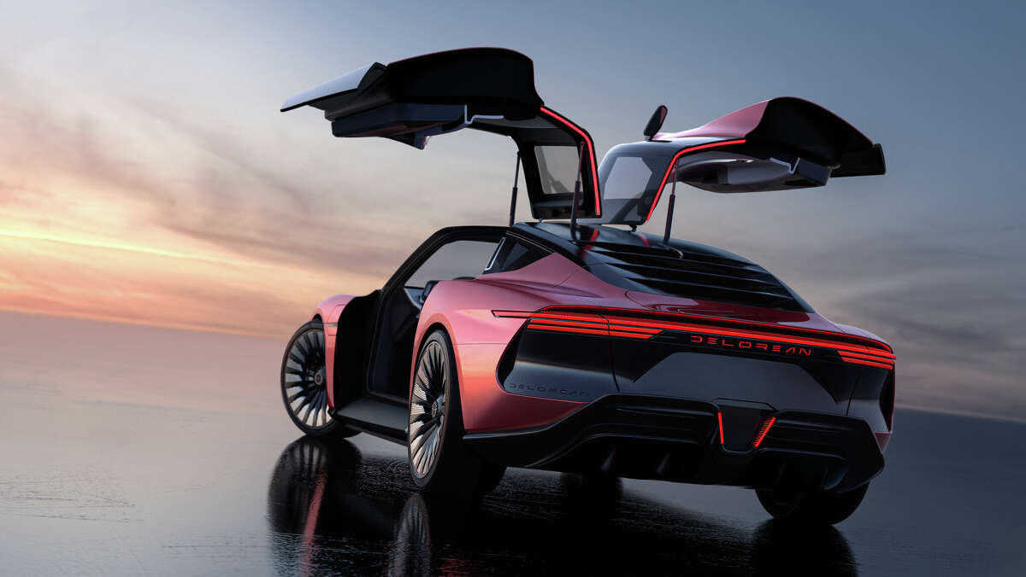
2019 EV Snapshot
2,400 EVs in San Antonio
45,000 EVs projected by 2030
2021 Snapshot
7,100 EVs in San Antonio
80,000 EVs projected by 2030
DeLorean unveils Alpha5, its new electric car engineered in San Antonio
Yes, it comes in red.
Santana, Steven. May 31, 2022. MySanAntonio.com
Photo courtesy DeLorean Motor Company

Slide 3
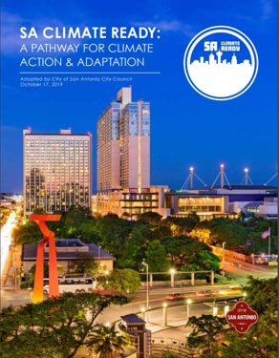
I. Policy: Climate Action + Air Quality
In October 2019, San Antonio committed to carbon neutrality by 2050 with the passage of the SA Climate Ready Plan.
2016 transportation ghg emissions were 38%.
2019 Community GHG Inventory
The Ozone Attainment Master Plan was adopted in June 2019.
In April 2022, the EPA announced a proposed action to move the “San Antonio area” from Marginal to Moderate Nonattainment for ozone.

Slide 4
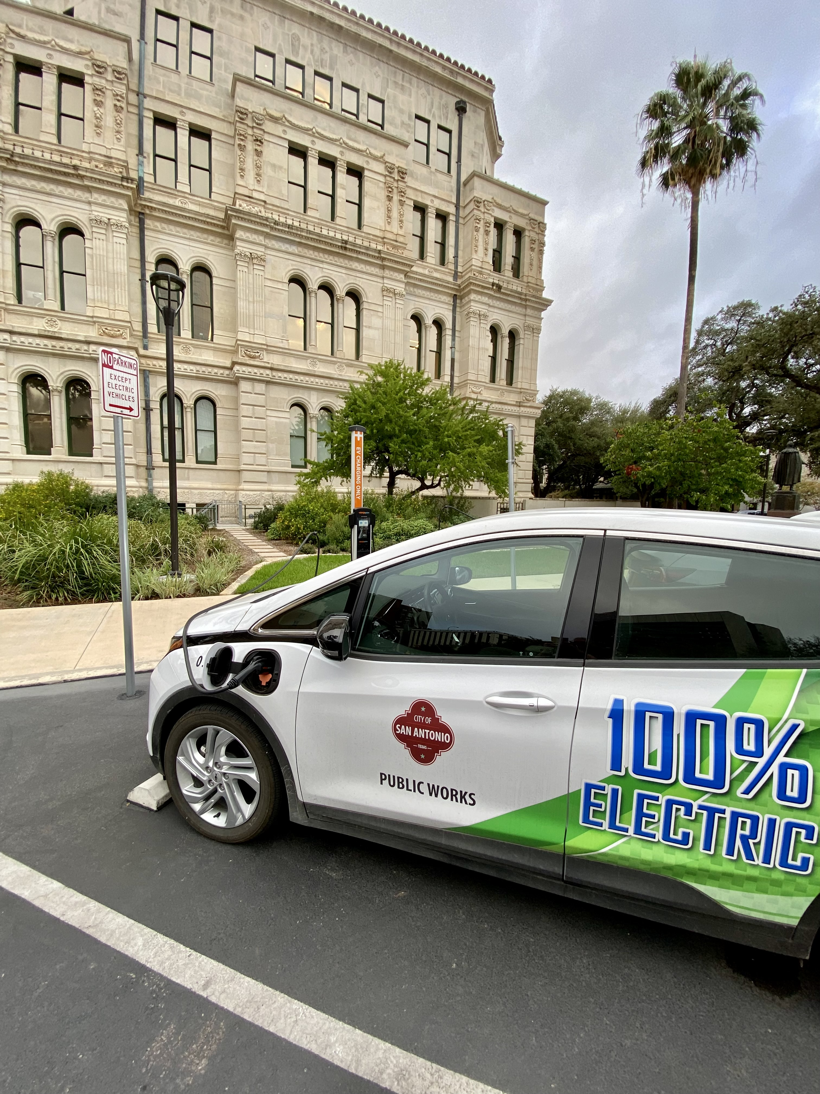
I. Policy: Sustainable Fleet Management Directive
Leading by example
19 electric fleet vehicles procured in 2021​
23 fleet EV charging stations installed in 2021​
25 Hybrid and 15 BEV light-duty vehicles procured in 2022​
Projected 100 fleet EVs by 2025

Slide 5
II. State and Regional Planning
“The alternative fuel corridors are from the FHWA and part of the USDOT/Bureau of Transportation Statistics’ National Transportation Database. Alternative fuel station data comes from the National Renewable Energy Laboratory (NREL).”
Planned DC Fast Charge Station
VW Settlement funds administered by TCEQ
Grant amount: $418,641
Number of Activities: 4
Retrieved September 14, 2022 from: https://www.txdot.gov/apps/statewide_mapping/StatewidePlanningMap.html

Slide 6
III. Stakeholder and Community Engagement

Slide 7
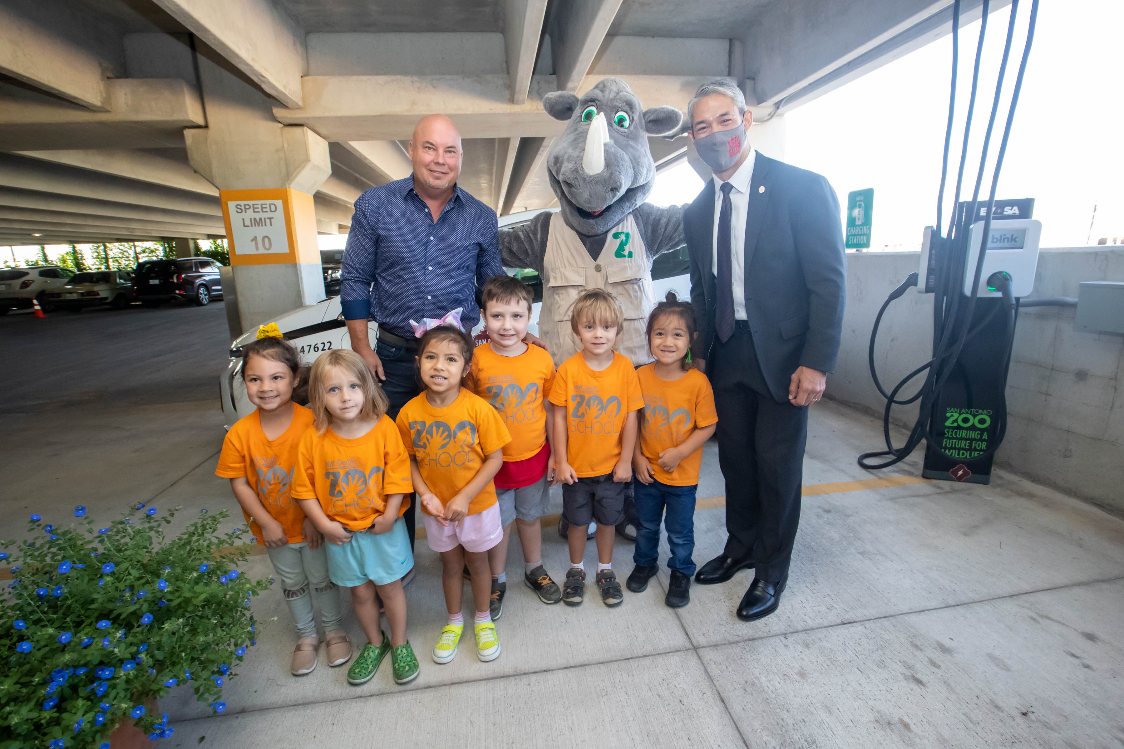
IV. Site Planning: Publicly-accessible EVSE
25 city-owned sites including parking lots, parks, community centers and the San Antonio Zoo!
Historic funding through TxVEMP, Texas Volkswagen Environmental Mitigation Fund
Public-private partnership with Blink Charging
Co-branded to communicate that San Antonio is EV-friendly
Notes:
JULIA

Slide 8
IV. Site Planning: Accessibility Design Recommendations
State technical memo=20% of stations, no less than 1 per site
U.S. Access Board released recommendations July 2022
City of San Antonio will comply with both, pending review by Texas Department of Licensing and Regulation
Applicable to EV Chargers at:
State or local government offices
Public parks
Municipal building parking lots
Street parking and the public right-of-way
Residential housing facilities provided by a state or local government
Public EV charging stations provided by a private entity
Fleet charging stations used by the federal government
Commercial fleet charging stations available to corporate clients
Rest stops along the Interstate Highway System

Slide 9
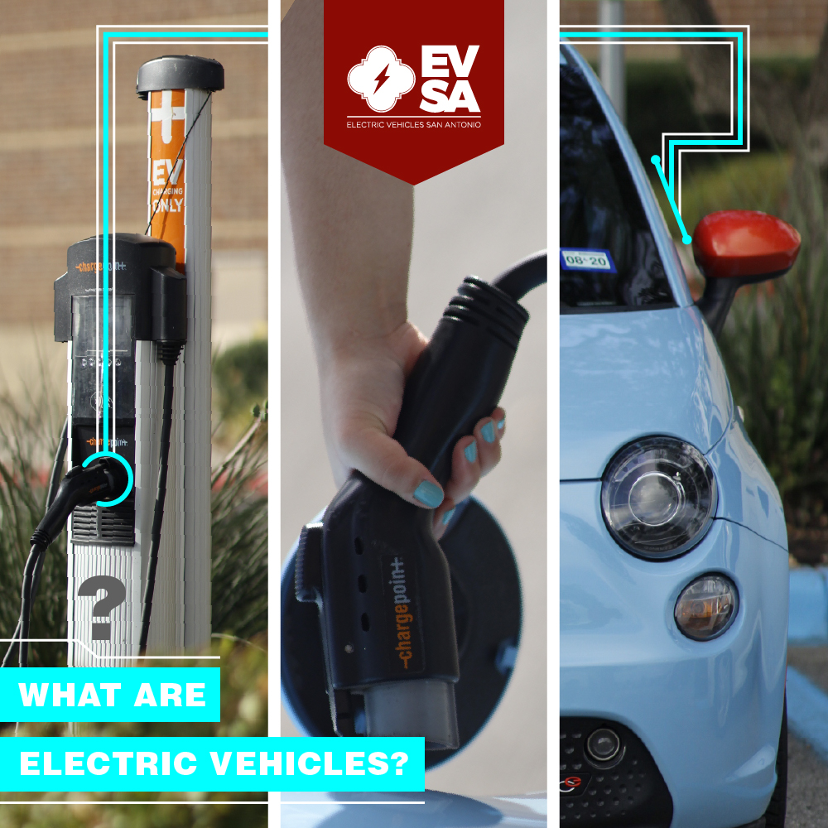
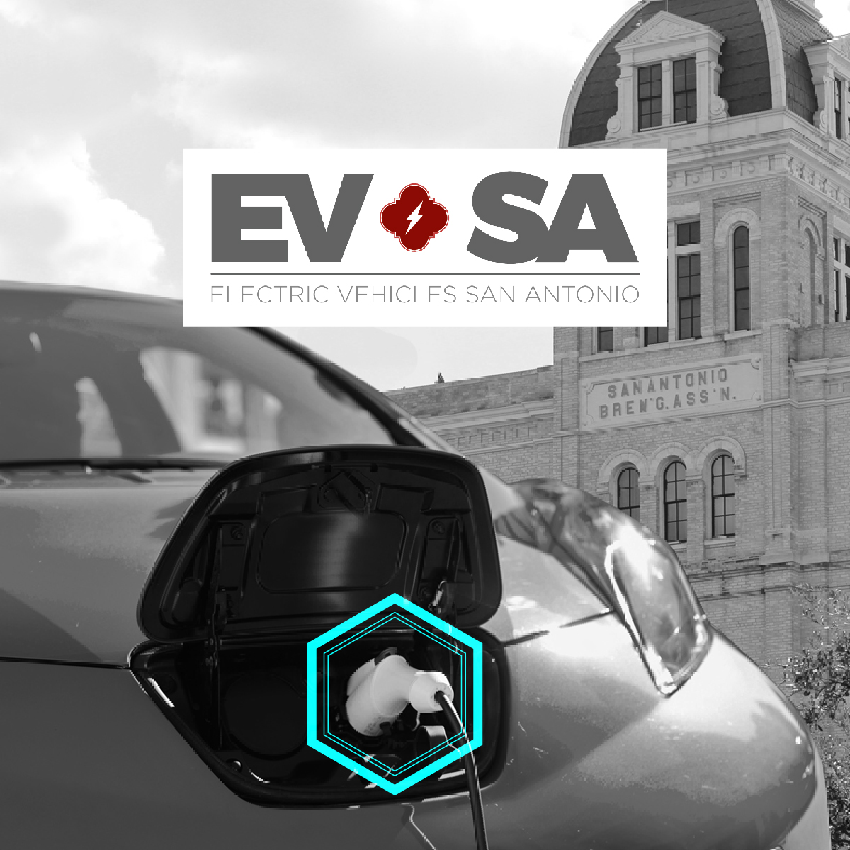
Thank You
Julia.Murphy@sanantonio.gov
SAsustainability.com

